Slide 1
JWT Authentication in Oracle APEX & ORDS
Generate and Validate Secure Tokens Using PL/SQL Presented by Uthamaselvan
Technologies: Oracle APEX Oracle REST Data Services Oracle Database

Slide 2
Introduction
Modern applications require secure authentication for APIs and applications.
One popular method is JWT (JSON Web Token) authentication.
This presentation demonstrates how to implement JWT authentication using:
Oracle APEX
ORDS REST APIs
PL/SQL

Slide 3
What is JWT
JWT (JSON Web Token) is a secure method for transmitting information between parties as a JSON object.
JWT consists of three parts:
1️⃣ Header 2️⃣ Payload 3️⃣ Signature
Example Token: xxxxx.yyyyy.zzzzz

Slide 4
JWT Structure
JWT Token format:
Header.Payload.Signature
Example:
eyJhbGciOiJIUzI1NiIsInR5cCI6IkpXVCJ9 . eyJ1c2VyIjoiYWRtaW4iLCJleHAiOjE3MjAwMDB9 . SflKxwRJSMeKKF2QT4fwpMeJf36POk6yJV_adQssw5c
Each part is Base64 encoded.

Slide 5
Architecture
Application Flow:
User → Login API API → Validate Credentials API → Generate JWT Token Client → Send Token in Request ORDS → Validate Token API → Return Data
Components:
Oracle APEX
ORDS REST API
PL/SQL JWT Package

Slide 6
Process
We can see how to setup a Process for token validation
Prepare user master for generate token with user.
Client requests JWT token (login API)
ORDS generates JWT using APEX_JWT
Client sends token in Authorization: Bearer <token> header
ORDS validates token before serving protected APIs

Slide 7
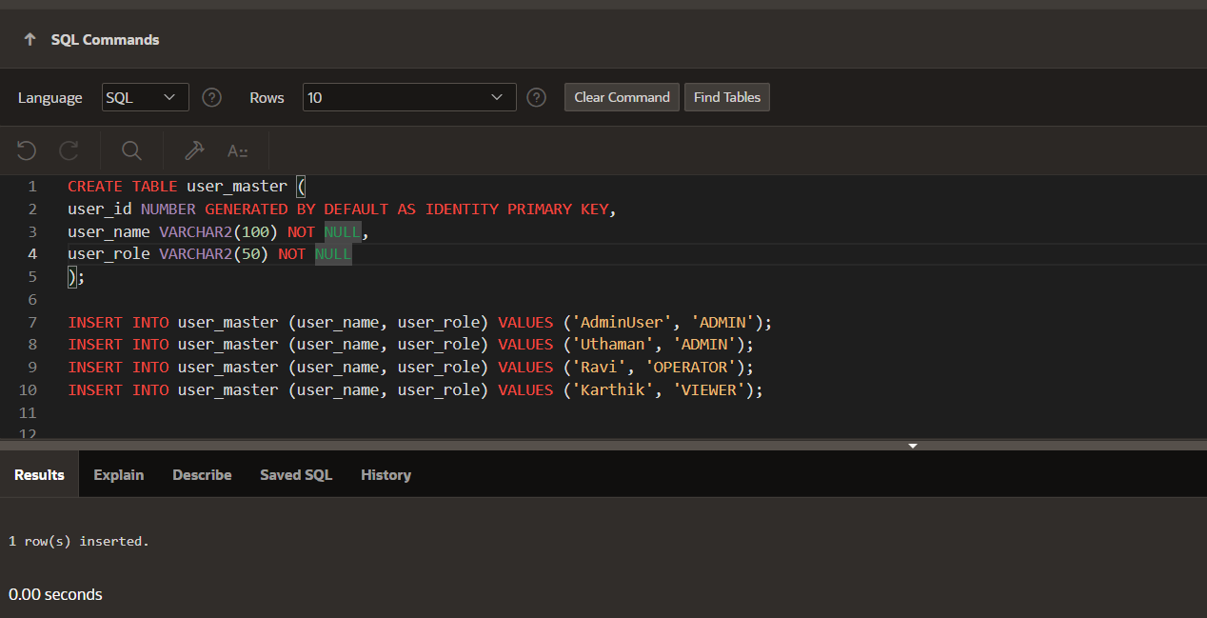
Prepare user master for generate token with user.

Slide 8
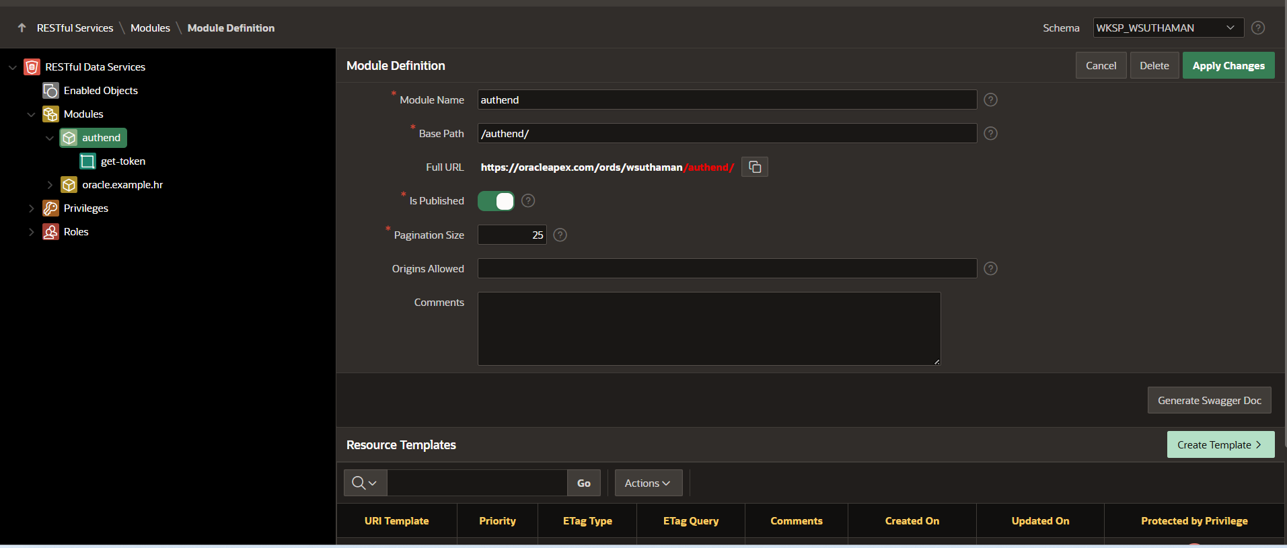
Create a ORDS Module

Slide 9
Create Template

Slide 10
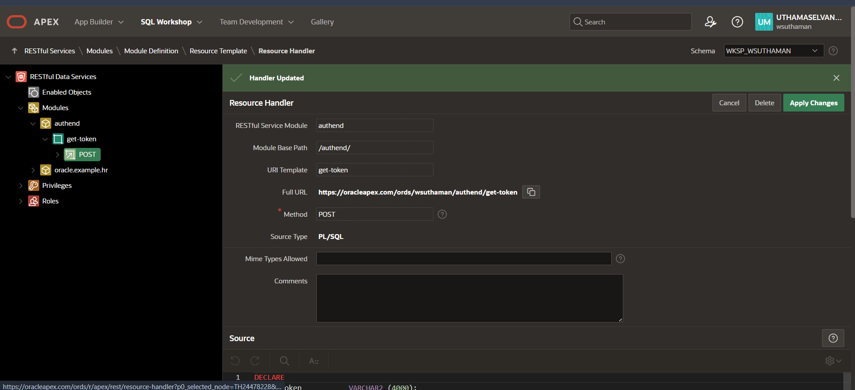
Create Handler

Slide 11
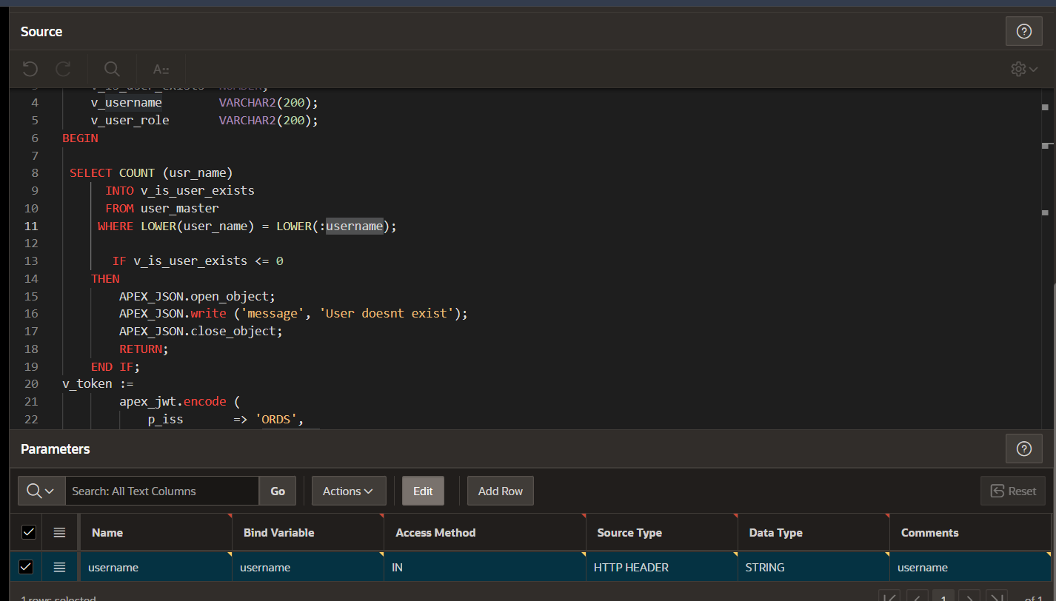
Create Handler code and parameters

Slide 12
Create Handler code and parameters
This code I have mentioned in my github, Link as below
https://github.com/uthamaselvan

Slide 13
Create Handler code and parameters

Slide 14
Now we can check using postman
Token generation end point url is :
https://oracleapex.com/ords/wsuthaman/authend/get-token
Method : POST
Header Parameters : Username (this user name need to provide as per our created user master)

Slide 15
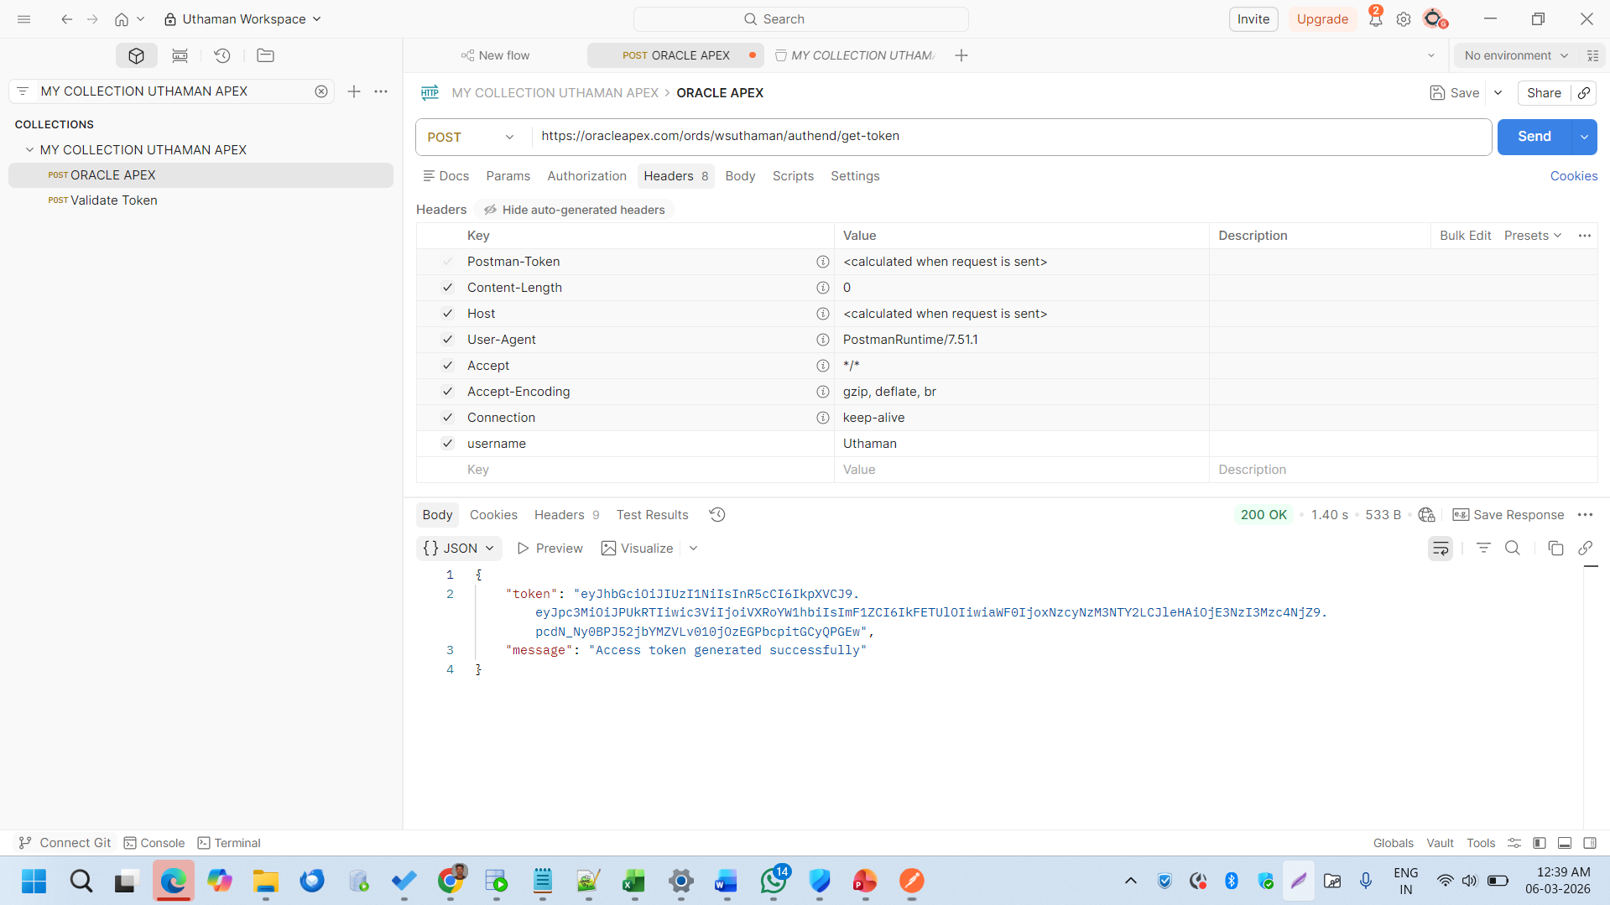
Now we can check using postman

Slide 16
Based on our postman request token is Generated

Slide 17
We have generated token now, hereafter we can validate the generate token

Slide 18
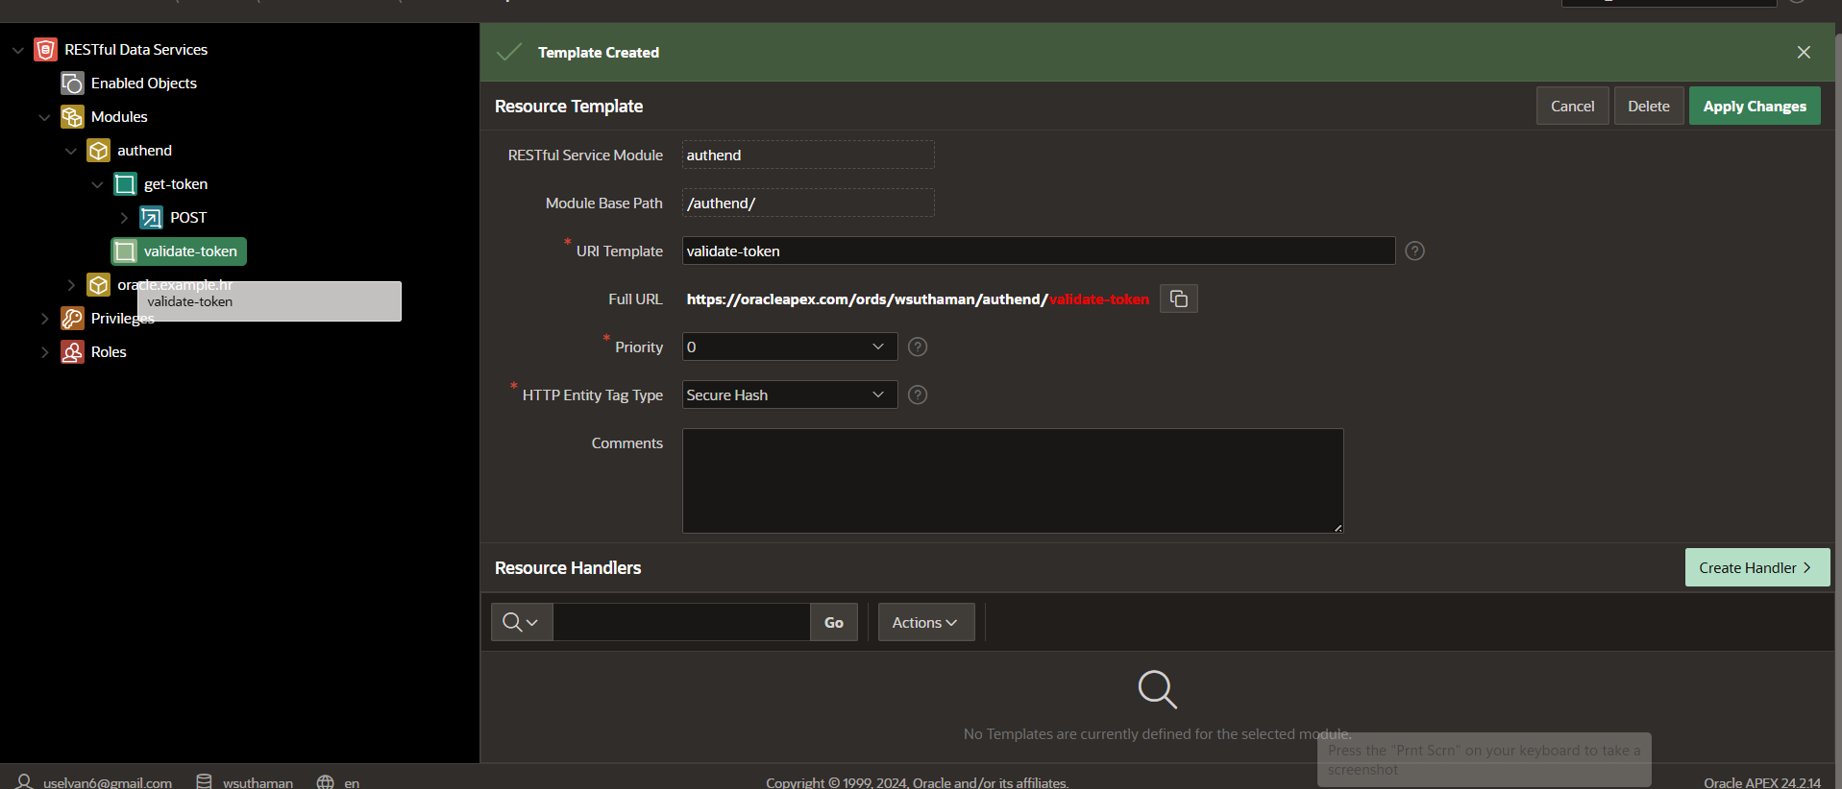
Create one more template as Validate token

Slide 19
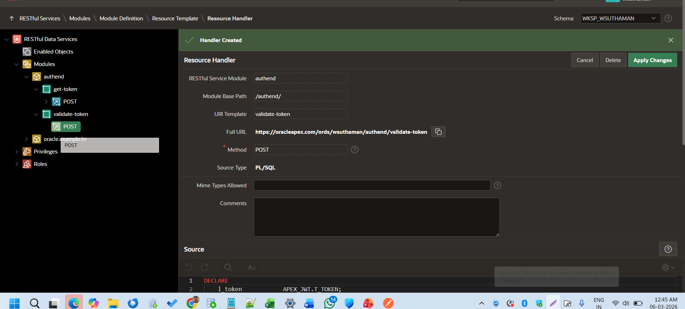
Create handler under validate token

Slide 20
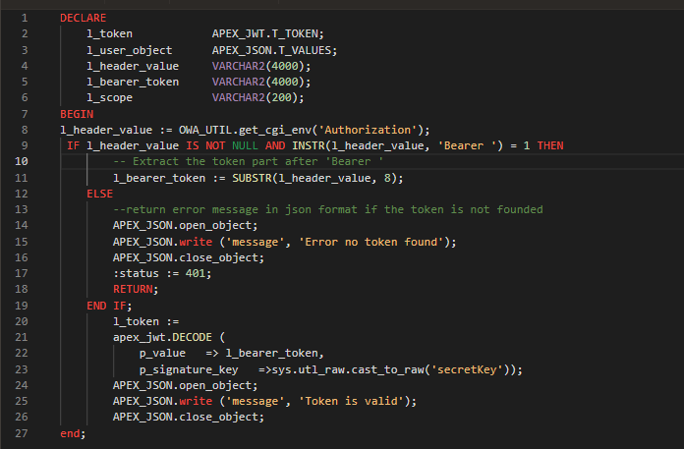
Source code is

Slide 21
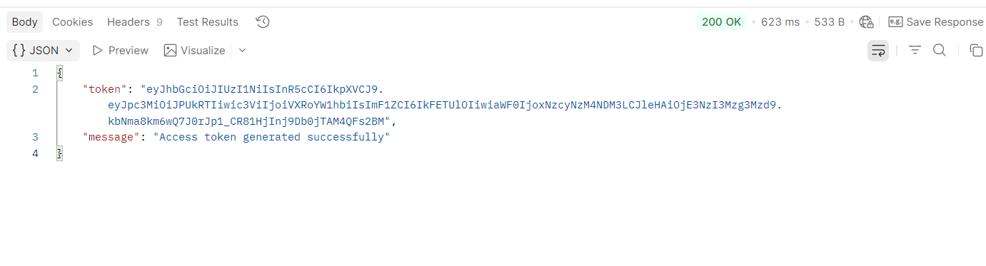
Now, we can check in Postman
Copy the token value from the Generate token response.,

Slide 22
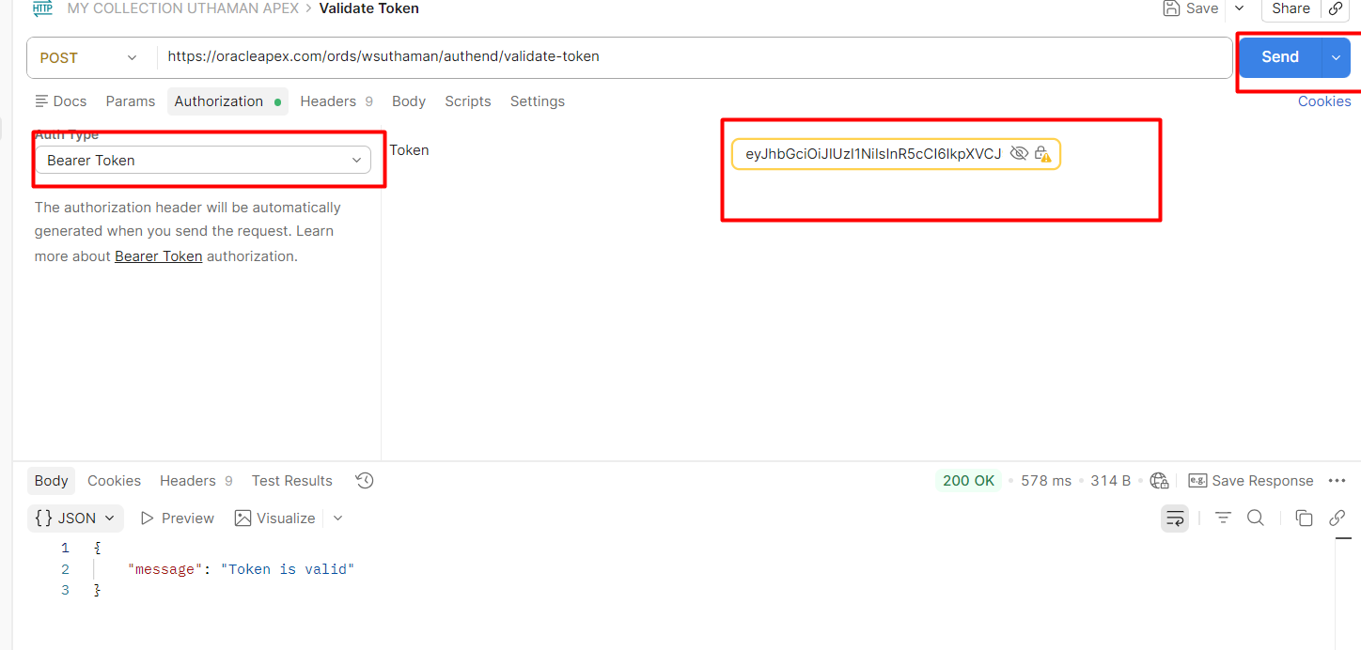
Now, we can check in Postman
Paste into the validate token new request

Slide 23
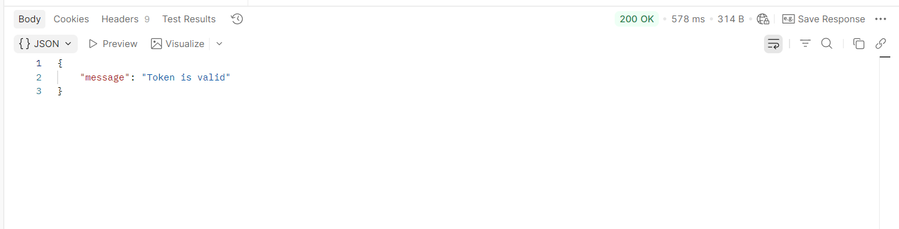
Success response
Paste into the validate token new request

Slide 24
Thank You
JWT Authentication in Oracle APEX & ORDS
Presented by
Uthamaselvan

